Slide 1
Analysis and Prediction of Crime Statistic in London.
By
Gunasegarran Magadevan - WQD170002
Mathavan Chandrasegaram - WQD17007

Slide 2
4W 1H Question
What :
This is an analytical study to categories the crime and also to produce insight info to prevent or reduce the crime in future.
Why :
To produce valueble/useable insight from historical raw data which may helps to prevent crimes which mostly people get involved
Where :
Raw data of criminal report in London City (UK)
When :
Criminal record from Jan 2008 - Dec 2016
How:
Use few analytical tools to process the raw data and comeout with useful insight/prediction.

Slide 3
Overview
We have use data of criminal records happening in London city during Jan 2008 until 2016 to analyze and produce some useful insight from the raw data.
We have categories the crime by month, year, severity of crime, type of most happening crime in city, etc.
This help to focus on the dangerous crime and prevent it moreover it could bring awareness among people around the city.
We also produce visualization of crime based on boroughs of the city and the population against it.
Hence, graph has been plotted on minor crimes against major crimes to show each major category crime among its minor category crime.

Slide 4
Motivation
Currently there are few bodies official and nonofficial teams are working to streamline the crime management processes and to improve current method of crime management.
As such, the outcome of this analysis will enable them to focus on specific problems or area and formulate the targeted solutions

Slide 5
Objectiive
Aim to produce useful insight by using clustering data analytical.
To visualize crime rate by borough, major category, minor category and populations.
To summaries the top categories of crime by borough and identify top problem spots.

Slide 6
Data Set
The dataset is consisting by 7 variables:
lsoa_code: code for Lower Super Output Area in Greater London.
borough: common name for London borough.
major_category: high level categorization of crime.
minor_category: low level categorization of crime within major category.
year: year of reported counts, 2008 − 2016.
month: month of reported counts, 1 − 12.
value: monthly reported count of categorical crime in given borough.
The variables lsoa_code, borough, major_category, minor_category, year and month are categorical variables, while value is a discrete numerical variable.

Slide 7
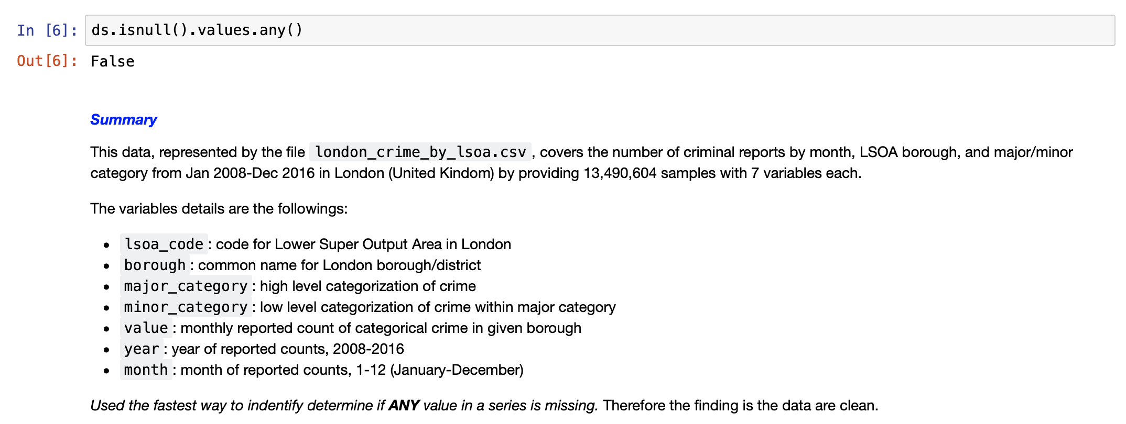
Data Cleaning
From the dataset, we used the used the fastest way to identify determine if ANY value in a series is missing. Therefore the finding is the data are clean.

Slide 8
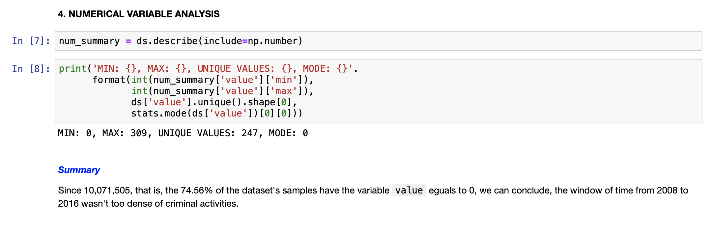
Numeric Variables Analysis :

Slide 9
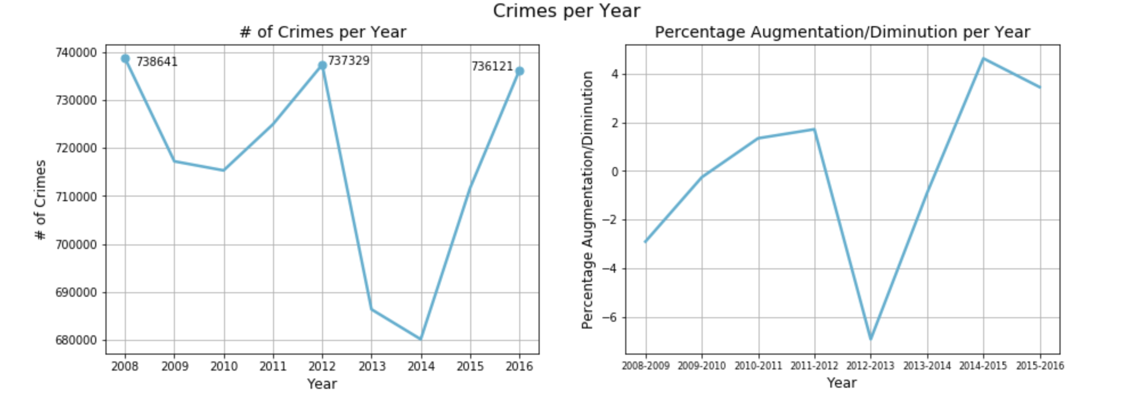
Numeric Variables Analysis :

Slide 10
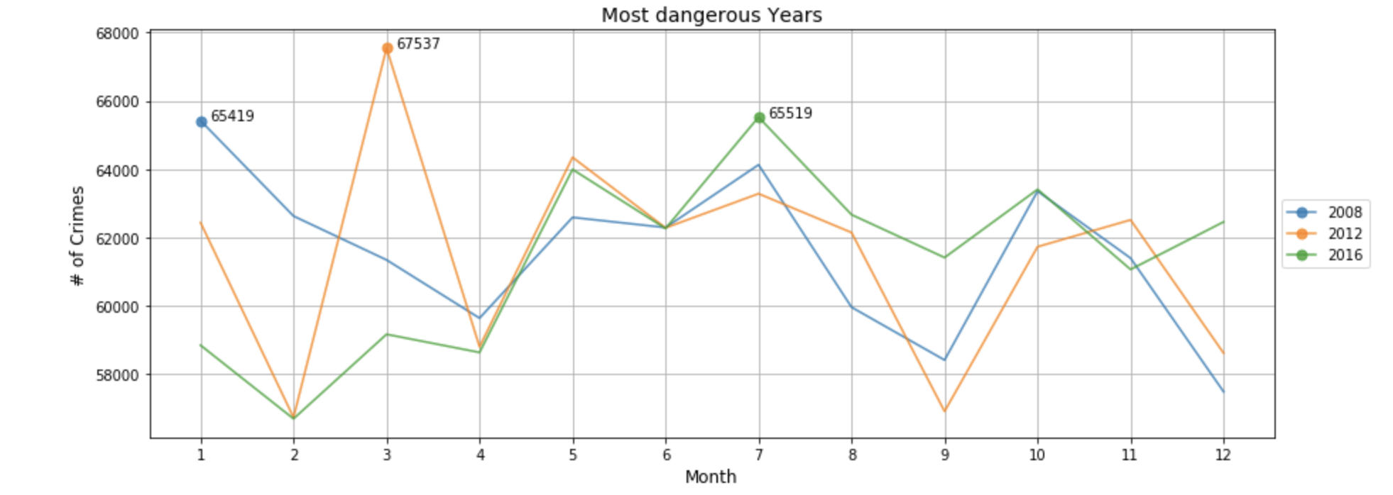
Numeric Variables Analysis :

Slide 11
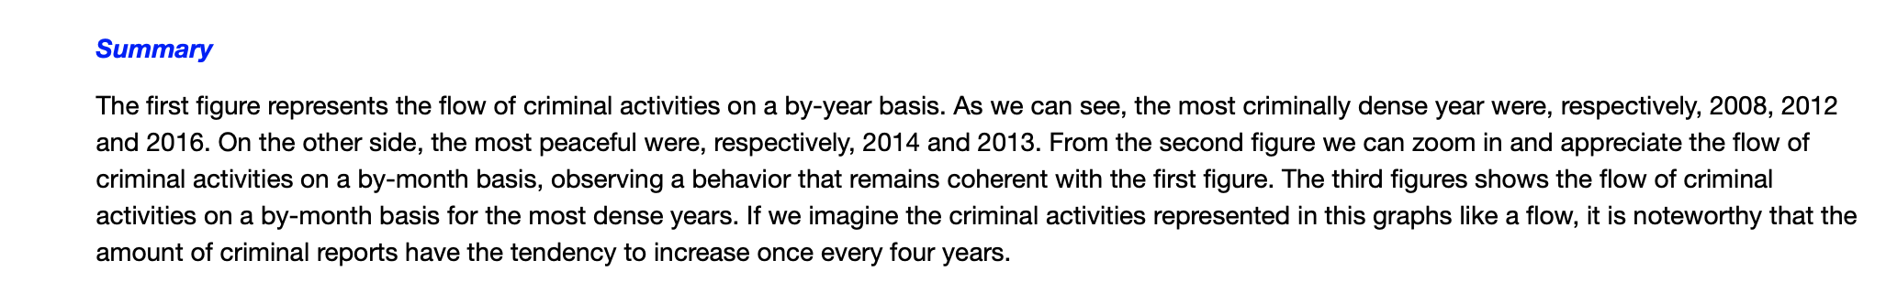
Numeric Variables Analysis :

Slide 12
Categorical Variables Analysis :

Slide 13
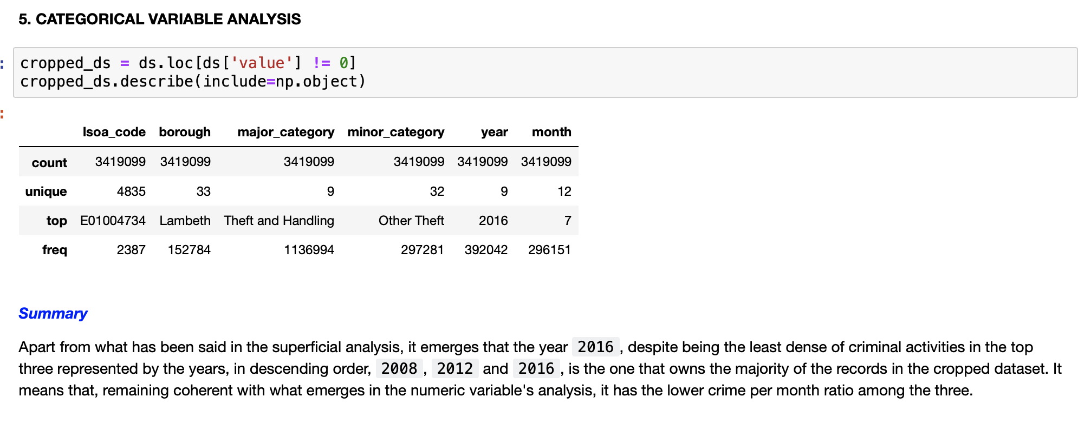
Categorical Variables Analysis :

Slide 14
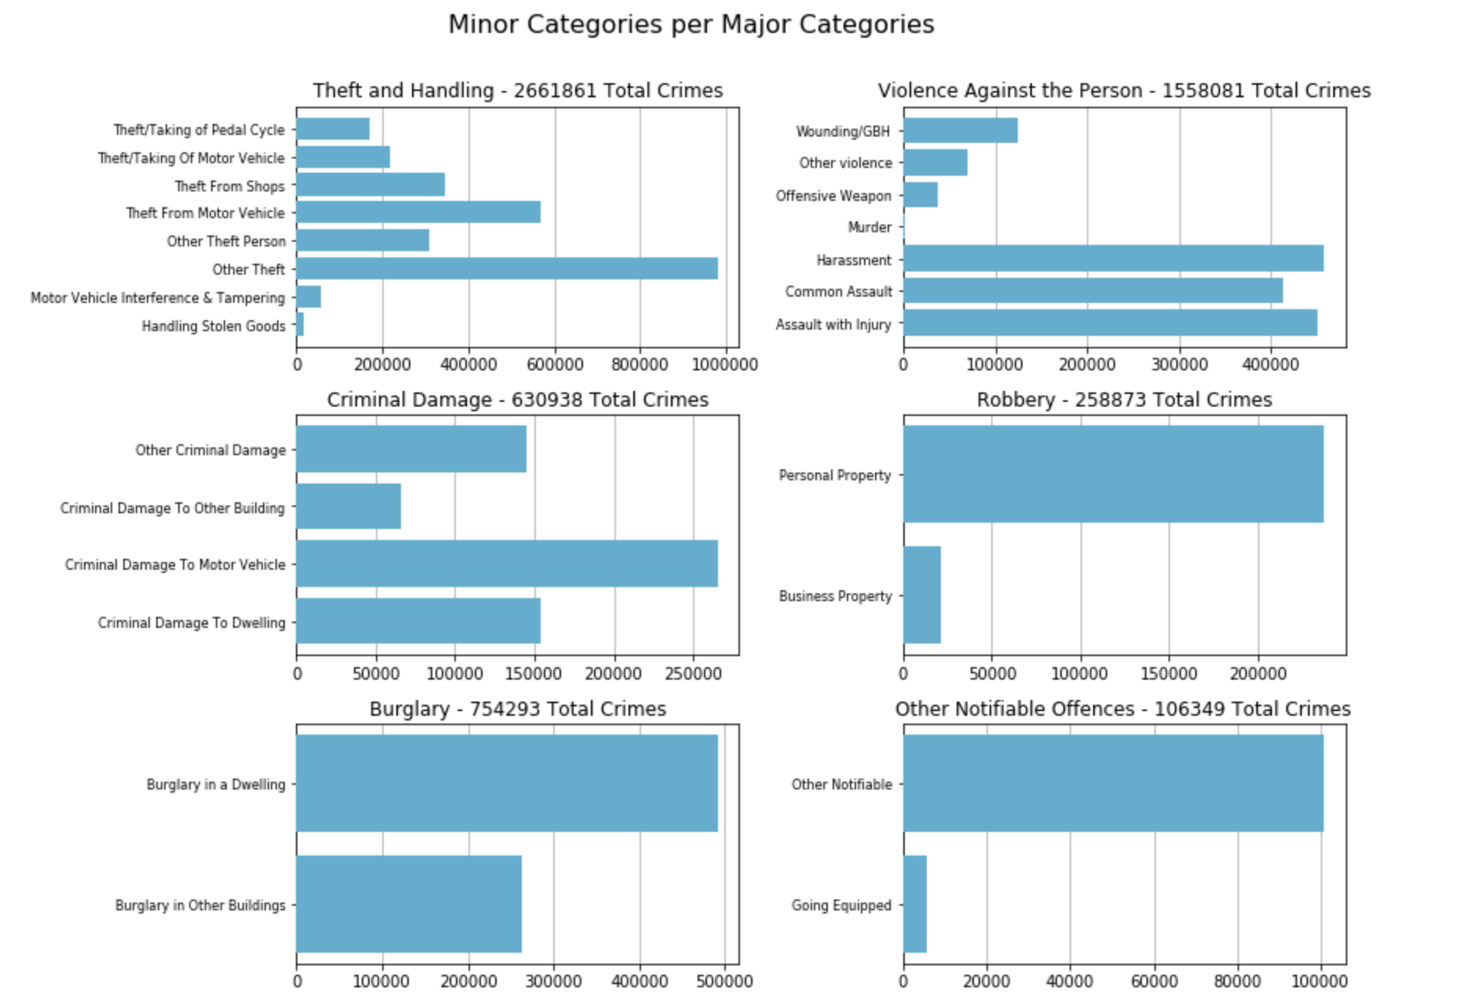
Categorical Variables Analysis :

Slide 15
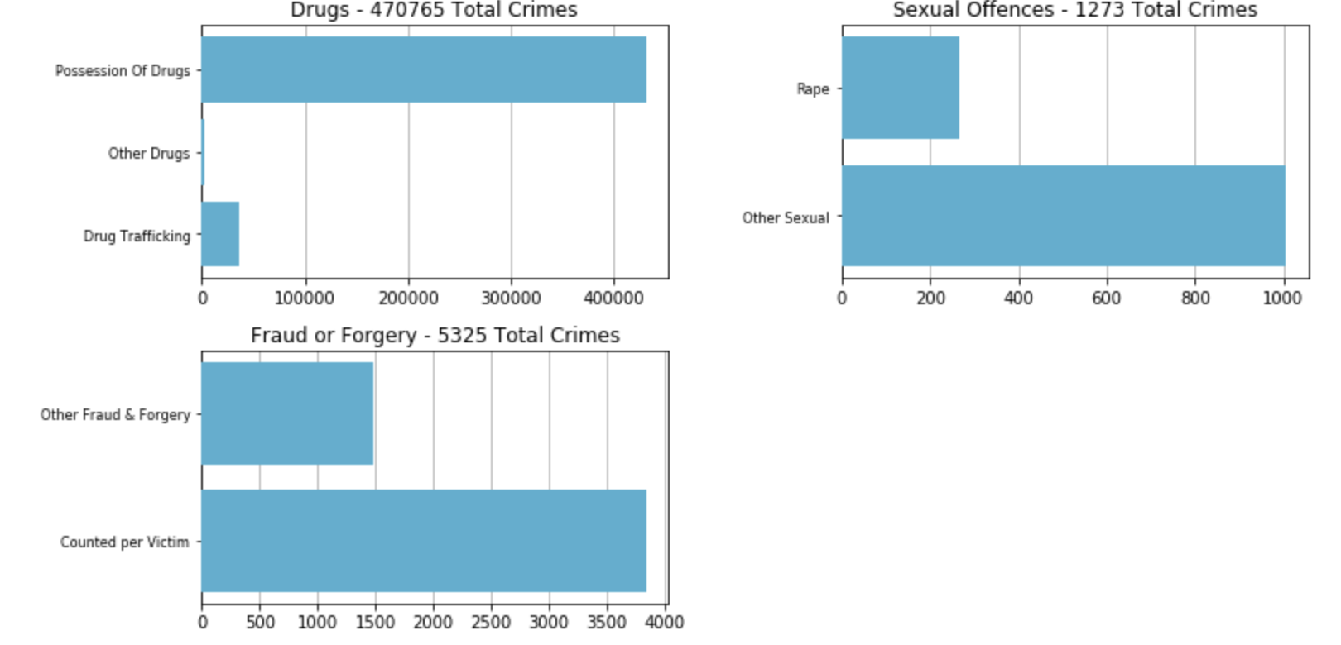
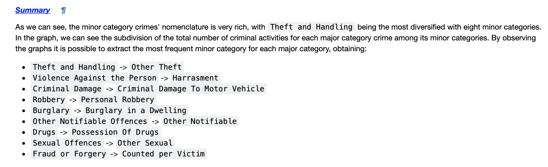
Categorical Variables Analysis :

Slide 16
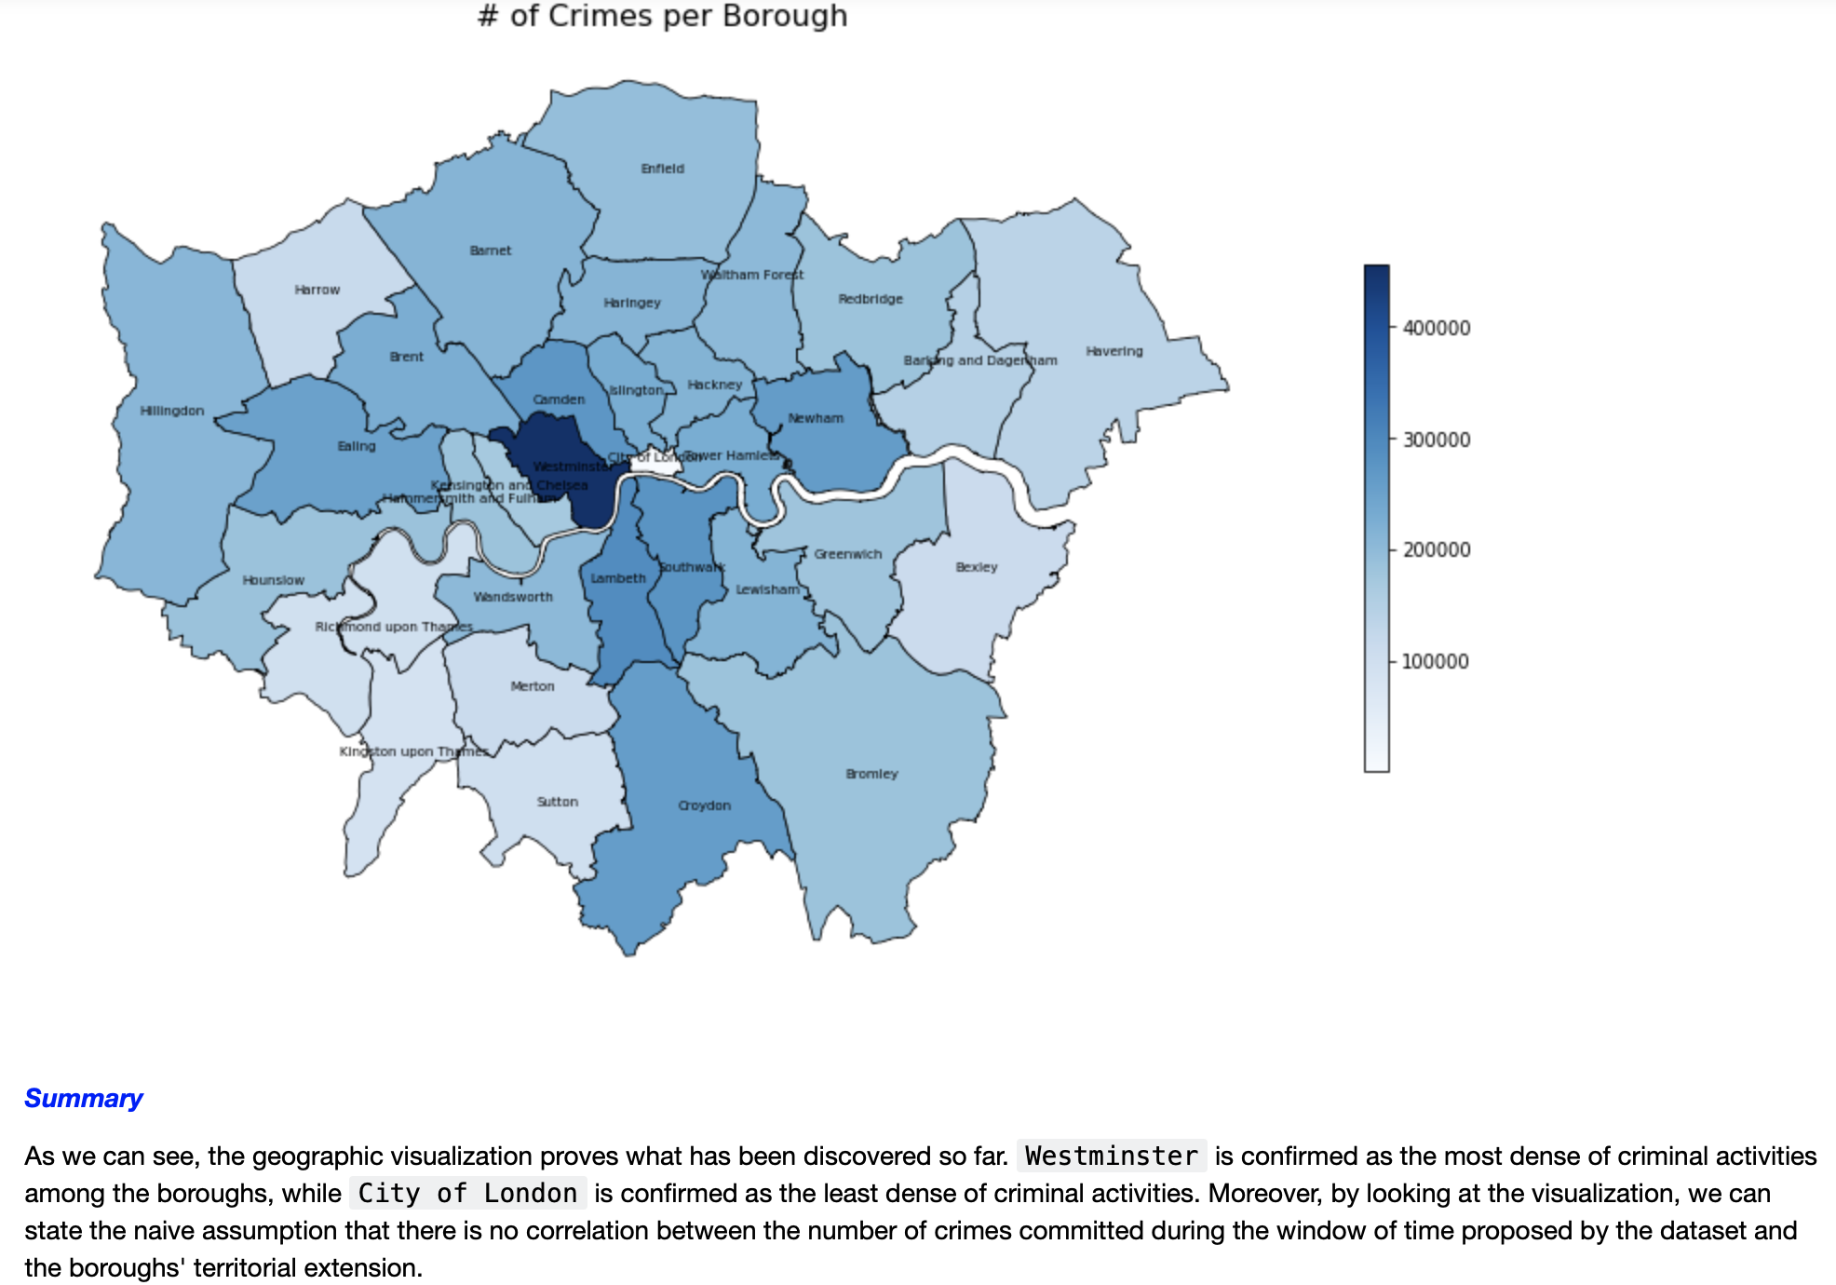
Categorical Variables Analysis :

Slide 17
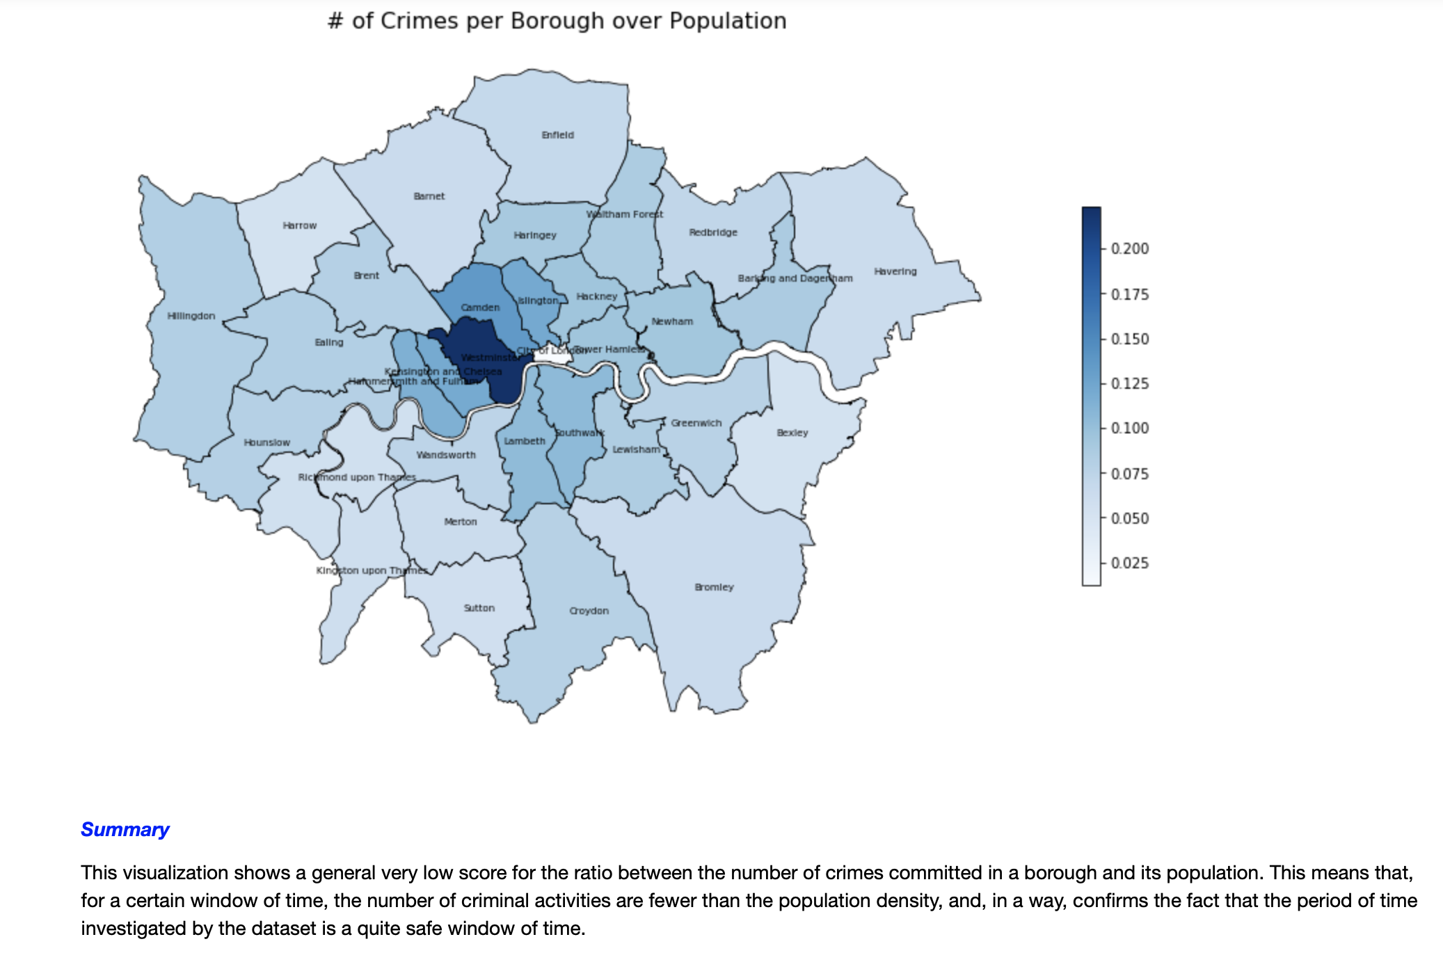
Categorical Variables Analysis :

Slide 18
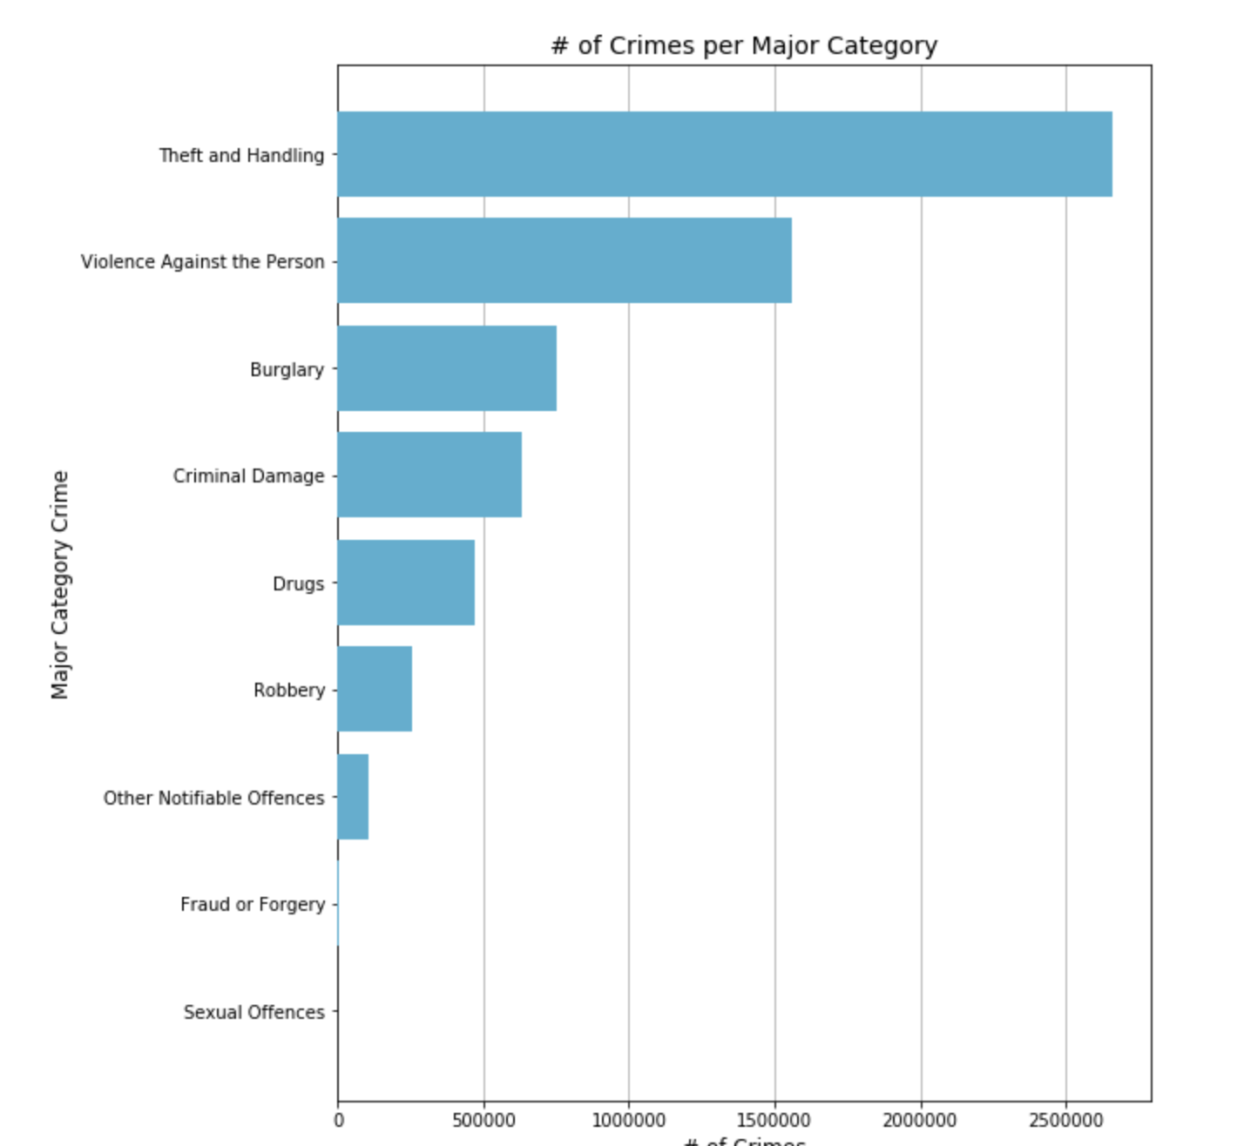
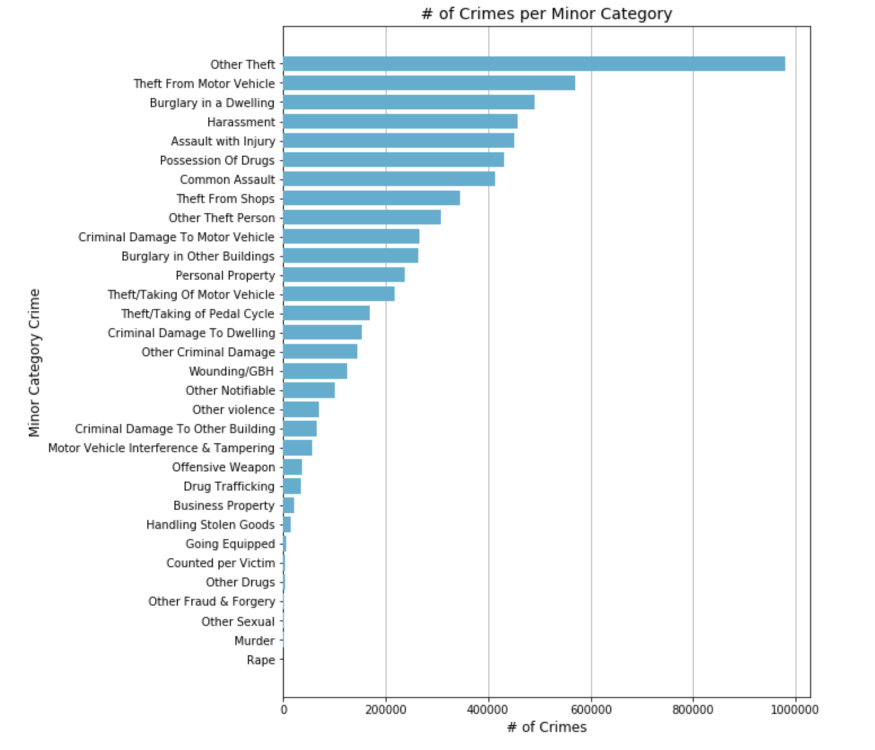
Categorical Variables Analysis :

Slide 19
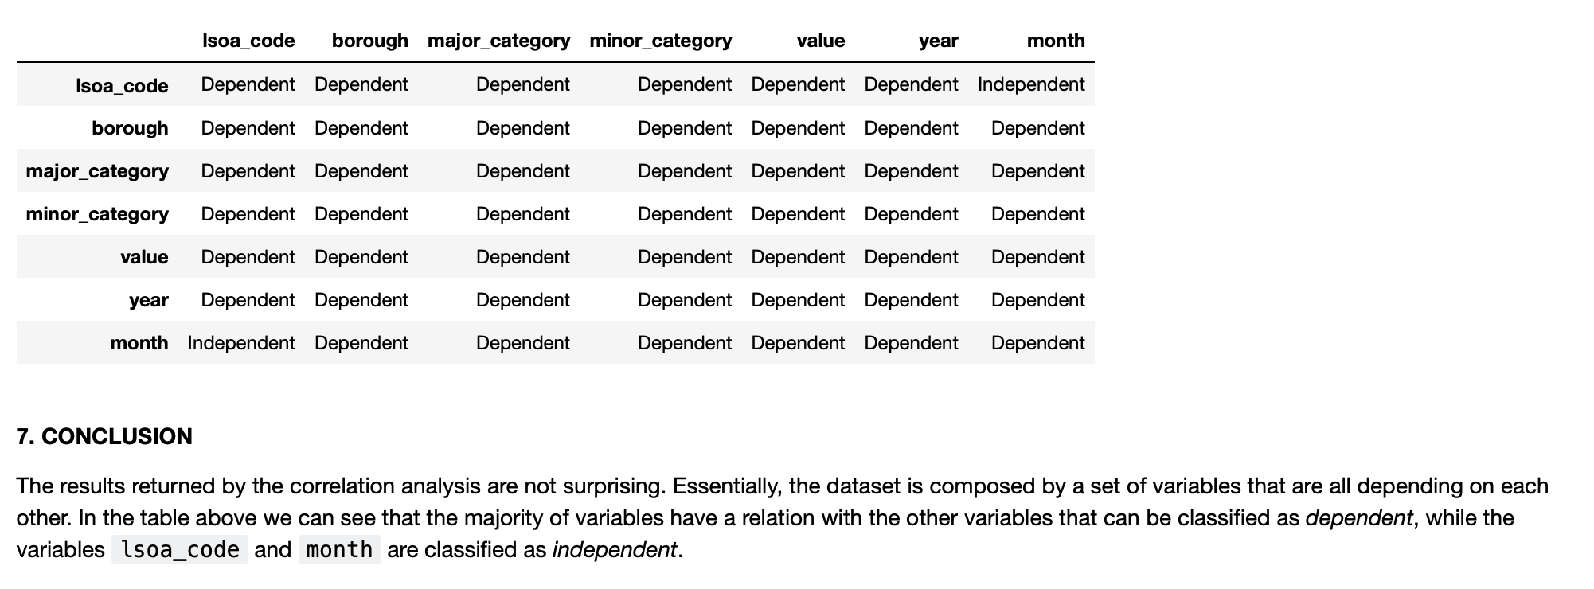
Correlation

